Slide 1
Heart Disease Prediction
Using Machine Learning With Flask-main
DHINESH S
20MSS009

Slide 2
Introduction
Heart disease is a leading cause of death worldwide.
Early diagnosis can help prevent serious complications.
Machine learning (ML) provides an accurate and efficient method for disease prediction.
Objective: Develop a heart disease prediction system using ML and Flask.

Slide 3
System Implementation Overview
Data Collection & Preprocessing: Collecting patient data and preparing it for model training.
Model Training: Using Random Forest for heart disease classification.
Web Application: Developing a user-friendly interface using Flask.
Deployment & Maintenance: Hosting on cloud, monitoring system performance.

Slide 4
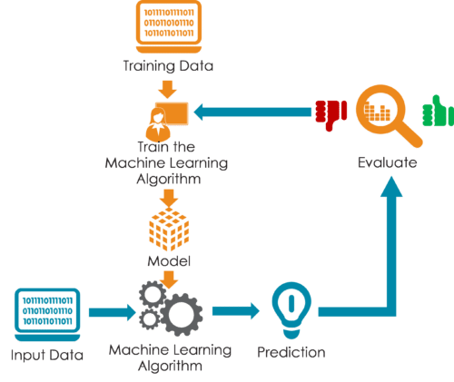
Machine Learning Model

Slide 5
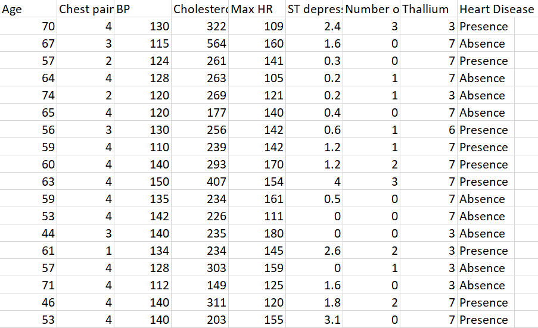
Dataset

Slide 6
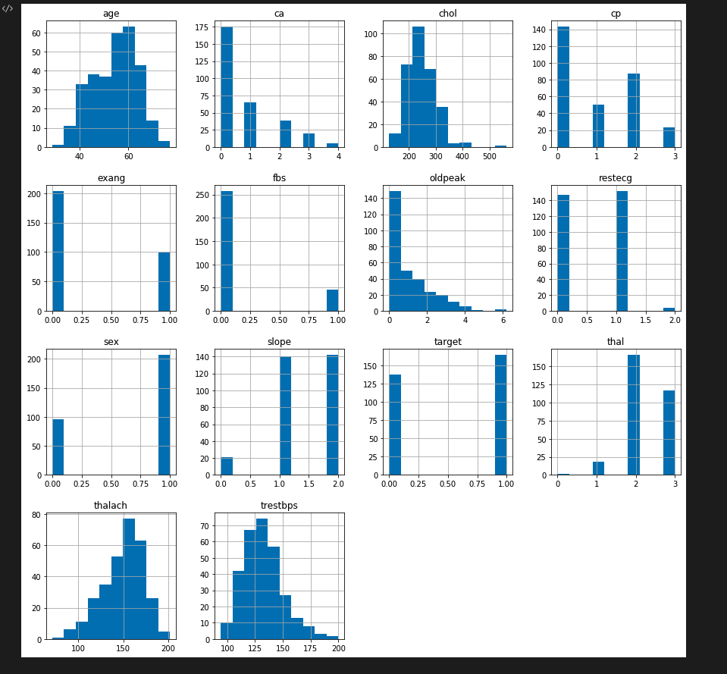
Data visualization

Slide 7
Flask-Based Web Application
The system is integrated into a user-friendly web application using Flask. The backend API handles user inputs, preprocesses the data, and applies the trained model to generate predictions. The frontend, designed using HTML, CSS, and JavaScript, provides an intuitive interface where users can enter their medical details. The prediction results are displayed, informing the user about potential heart disease risks.

Slide 8
Future Enhancements
Integration with More Diseases:
Predicting diabetes, hypertension, and stroke.
Real-time Data Processing:
Wearable devices (smartwatches, fitness bands) for continuous monitoring.
Advanced ML Techniques:
Deep learning models (Neural Networks, Transformers).
Mobile Application:
AI-powered chatbot & voice assistant for accessibility.

Slide 9
Conclusion
Machine learning-based heart disease prediction has the potential to transform early diagnosis and preventive healthcare. By integrating a Flask-based web application with cloud deployment, the system provides a scalable and accessible solution for users. Future advancements will focus on enhancing accuracy, real-time monitoring, and multi-disease prediction, further improving patient care and healthcare accessibility.

Slide 10


